Slide 1

Why Podiatric Medicine
From the perspective of a current podiatric medical student

Slide 2
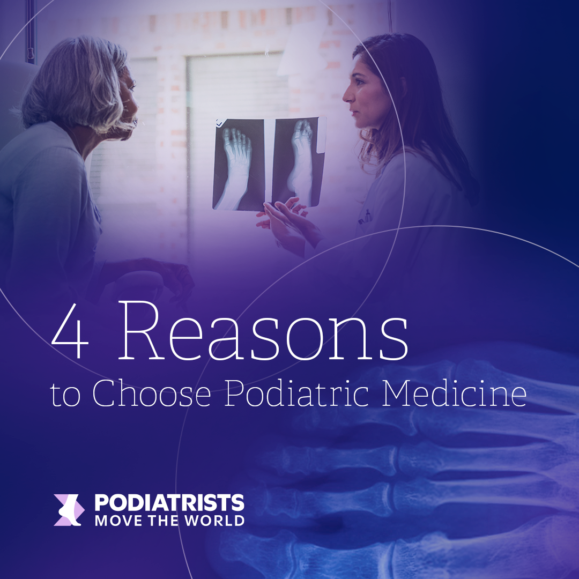

Slide 3
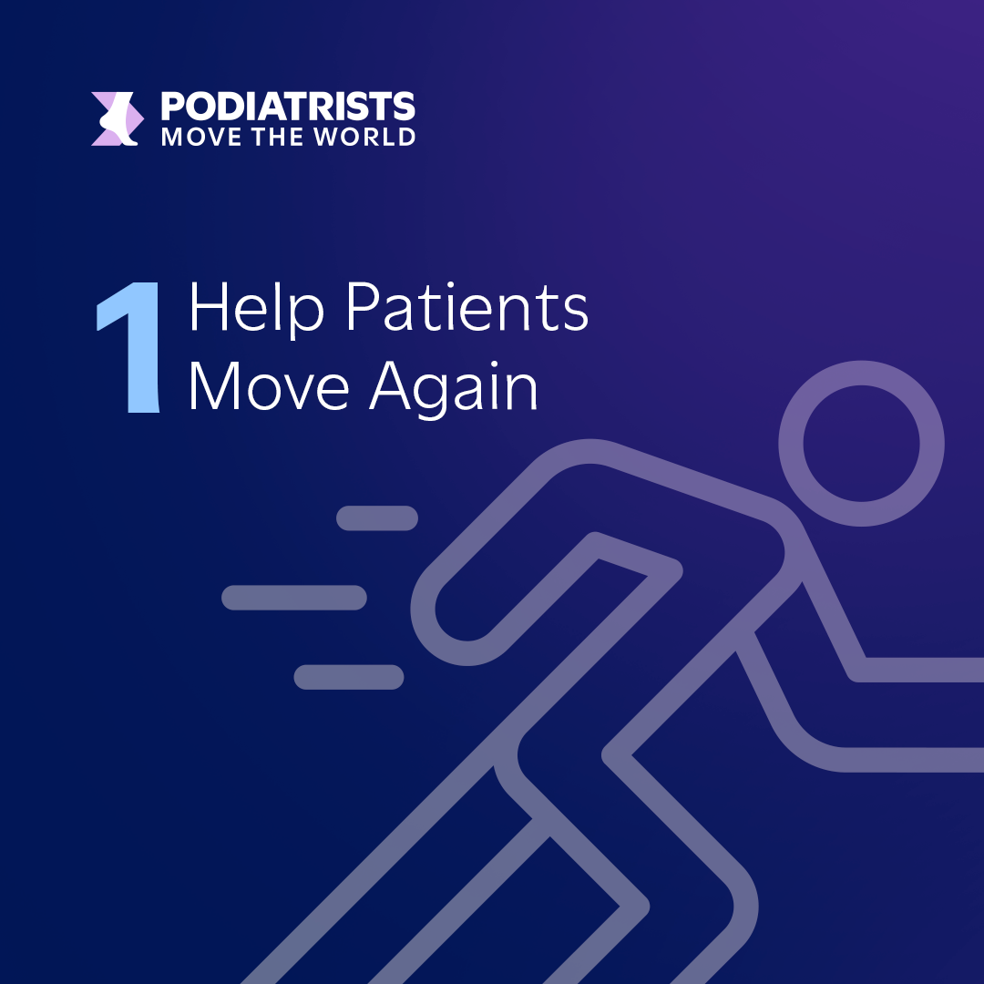
Notes:
Podiatric medicine is one of the few surgical careers where the results are often visible right away. It’s a career where you see your impact, sometimes before the patient even leaves the room.
› Visible, tangible results for patients. DPMs often help patients walk again, prevent amputations, or return to sports—sometimes in a single visit.
› Direct improvement in mobility and quality of life. For example, DPMs play a critical role in managing chronic conditions like diabetes, through wound care and limb preservation.
› Strong patient relationships and continuity of care. High patient satisfaction and long-term care relationships are common in podiatric medicine.

Slide 4
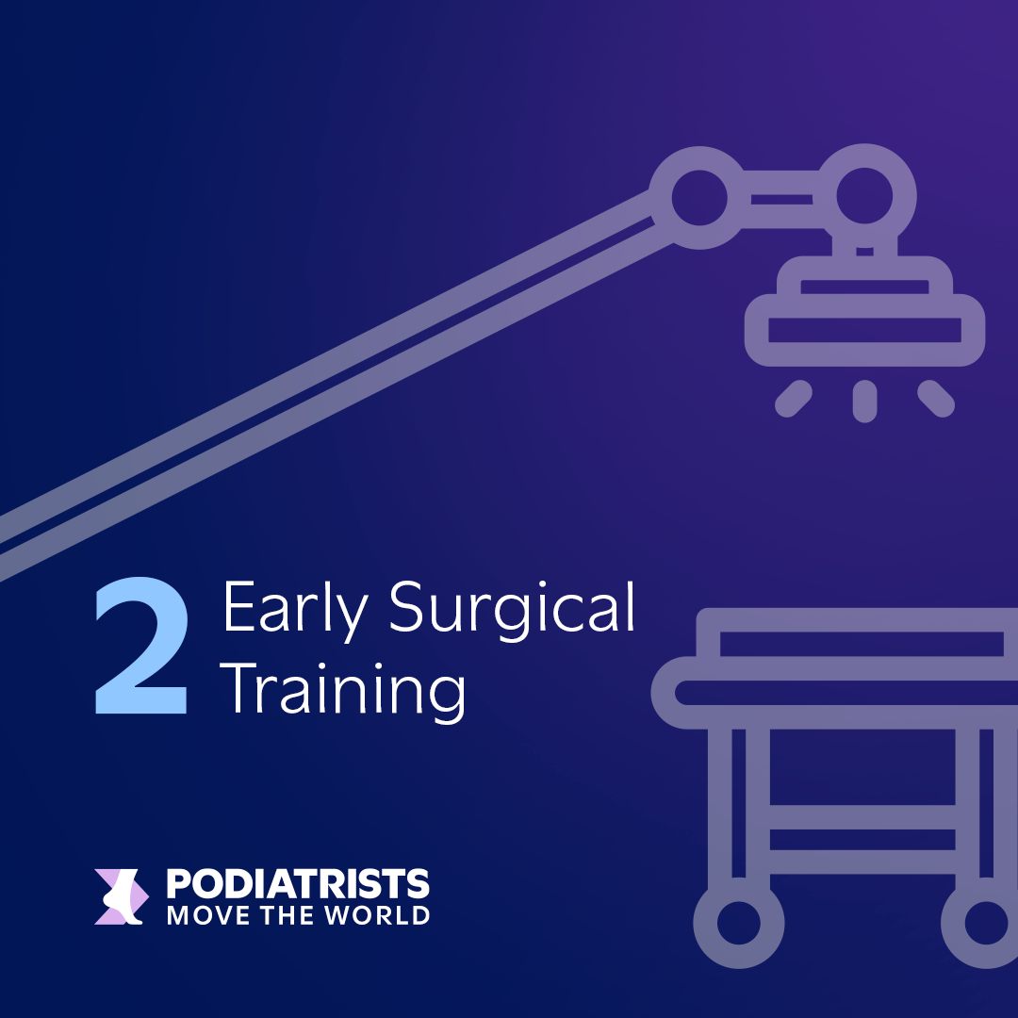
Notes:
For students who know they want to be in the OR, podiatric medicine offers something rare in the medical world: a clearly defined path to practice.
› A near 100% residency match rate for qualified applicants across all 11 DPM schools, compared to significantly lower match rates in MD/DO surgical specialties.
› A three-year surgical residency with hands-on training built directly into the program, rather than after general training, reducing the wait to specialize.
› A direct path to specialized care, including trauma, sports medicine, diabetic limb preservation, and more.

Slide 5

Notes:
Podiatric medicine is a medical and surgical specialty focused on restoring mobility and improving quality of life.

Slide 6
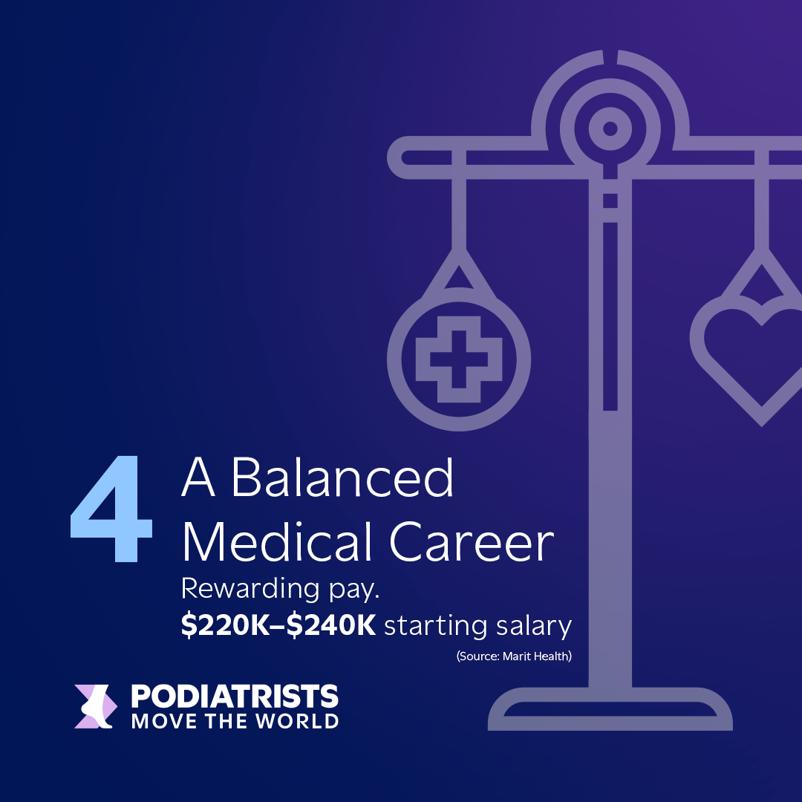
Notes:
Students today want careers that challenge them, but not at the expense of everything else. Podiatric medicine stands out as an opportunity to build a meaningful surgical career while still having a life outside the OR.
› Flexible schedules and practice settings. Podiatrists can structure their practices to fit their lifestyle, with fewer on-call demands than many MD/DO surgical specialties.
› Lower burnout compared to other surgical specialties, in part due to predictable hours and autonomy over caseload.
› Opportunities to work in hospitals, private practices, multidisciplinary groups, academic settings, and more.
With early surgical exposure, strong residency outcomes, and starting salaries of $220K–$240K*, podiatric medicine delivers both purpose and return on investment

Slide 7
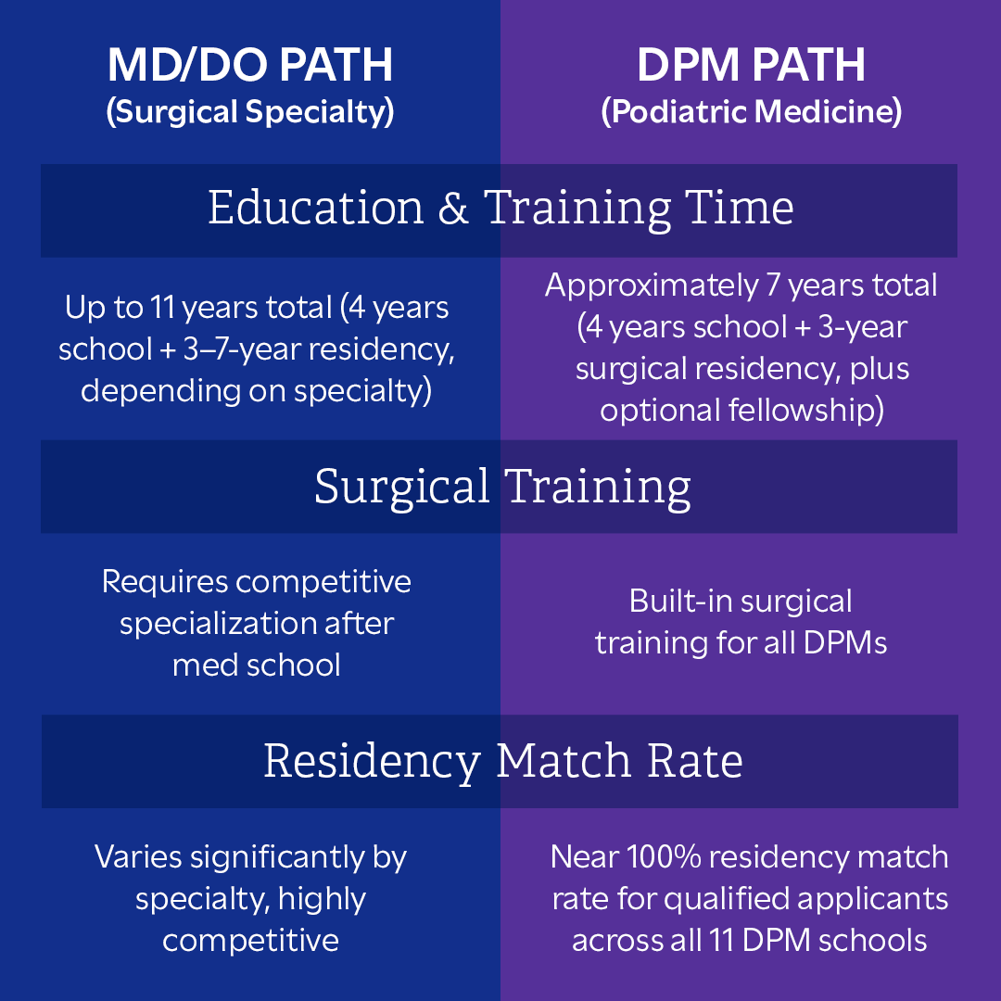

Slide 8
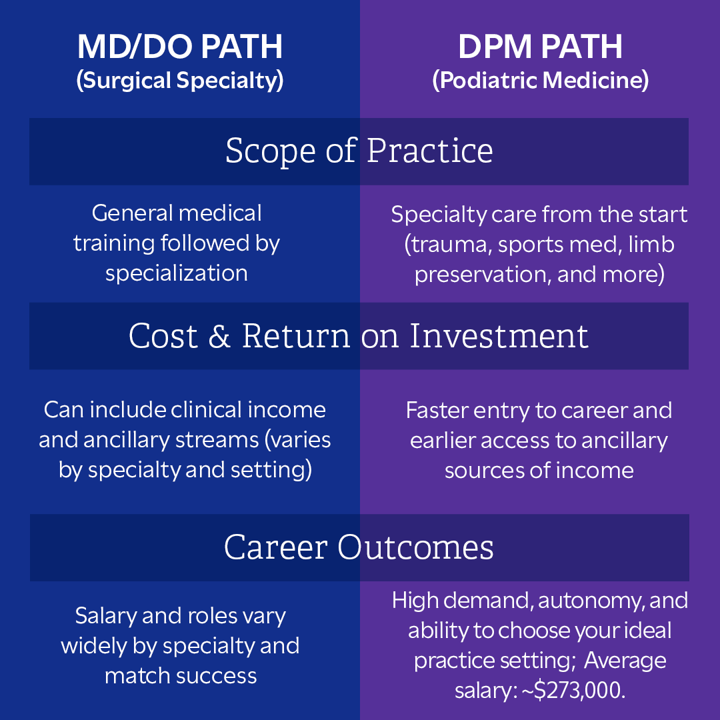

Slide 9
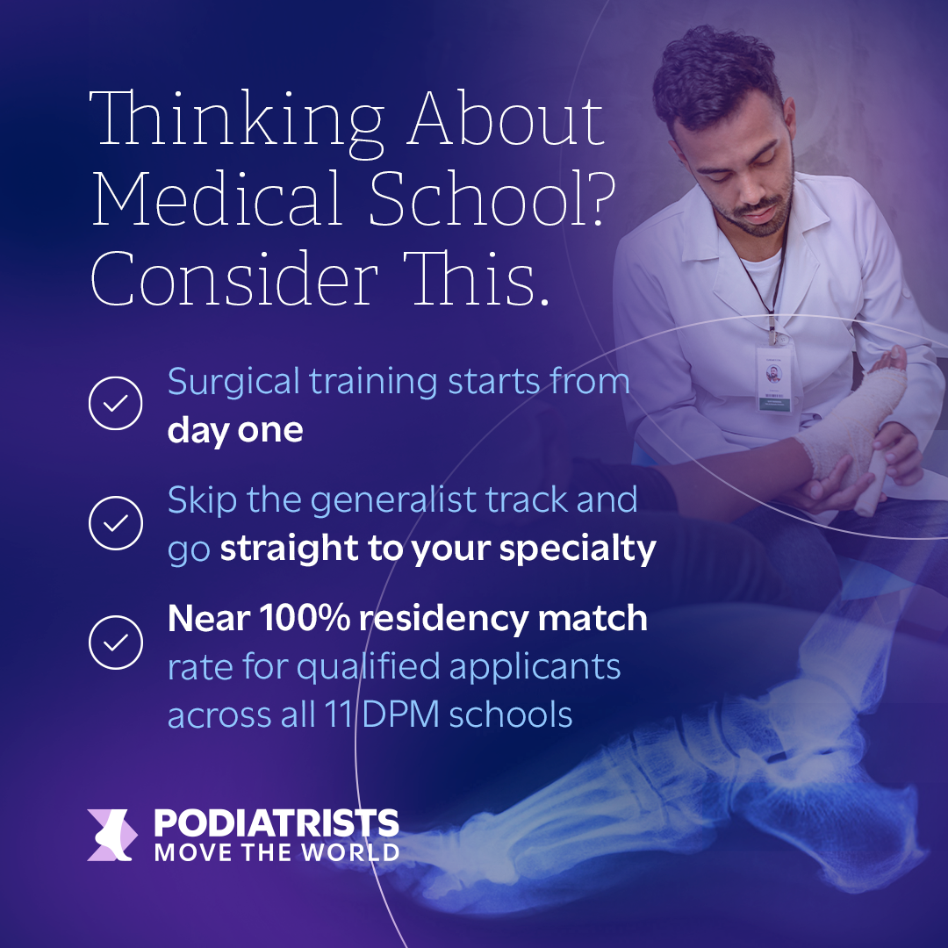

Slide 10
Thank You!
For more information visit discoverpodiatry.org

